Slide 1
Advanced Full Custom VLSI Design CND-221
Final Course Project
Section 21 - CND221_Group 10

Slide 2


Content
Overview on 4bit Microprocessor
Building Blocks and Schematics
Layout Design
Design Validation
Back Annotation Simulation Results

Slide 3
Overview
This project involves the schematic and layout design of a 4-bit microprocessor data path, including an ALU, a barrel shifter, and a register file using CMOS circuitry and Siemens VLSI design tools.

Slide 4
Content
Overview on 4bit Microprocessor
Building Blocks and Schematics
Layout Design
Design Validation
Back Annotation Simulation Results

Slide 5
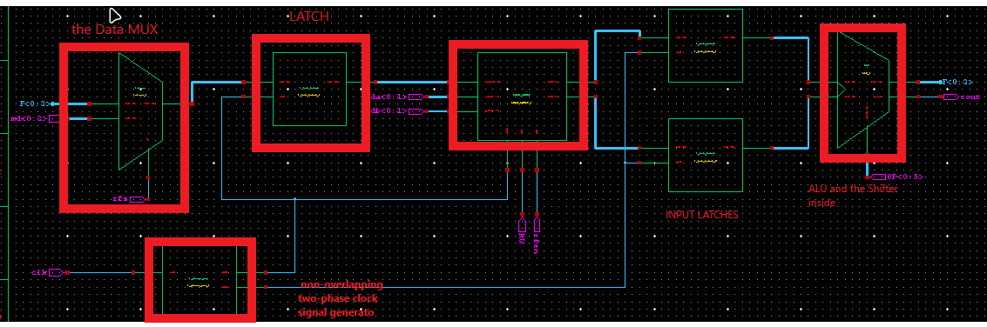
Building Blocks and Schematics
The ALU input data is loaded into the latch at the rising edge of the ALU clock (clk2), and the output is generated after a delay due propagation through the combinational logic of the ALU and the shifter. The central component of an ALU is an adder, and for this project a Carry select adder will be used.
A shifter provides data manipulation capabilities. A barrel shifter will be used because it has a very efficient layout and can perform n-bit shifts in a single clock cycle.
The register file is a block of memory that provides the data inputs to and stores outputs from the ALU.

Slide 6
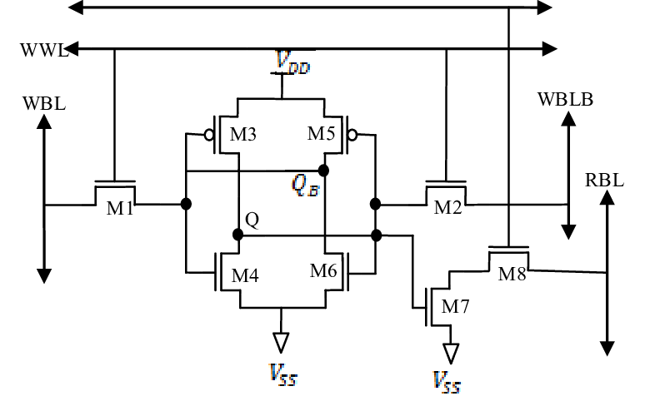
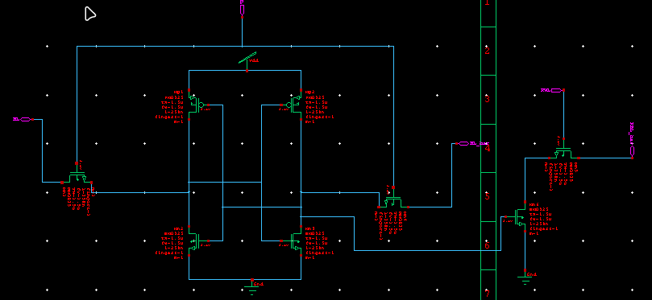
Building Blocks and Schematics
SRAM:
The circuit of an 8T SRAM (Static Random-Access Memory) cell consists of eight transistors configured to store a single bit of data while enhancing read stability and write efficiency

Slide 7
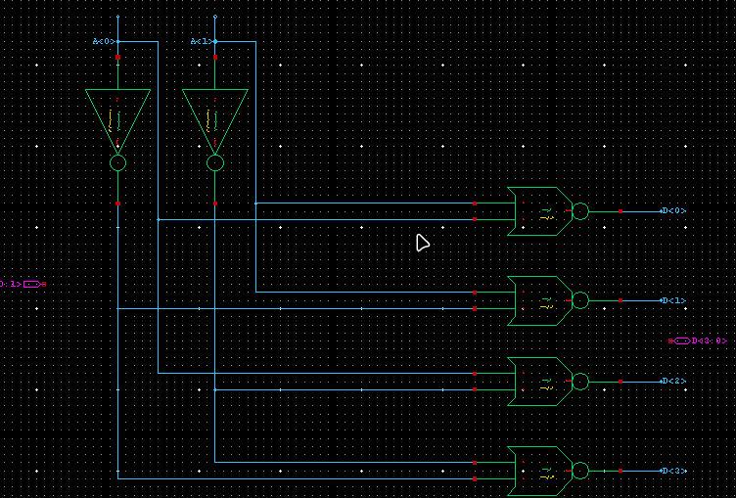
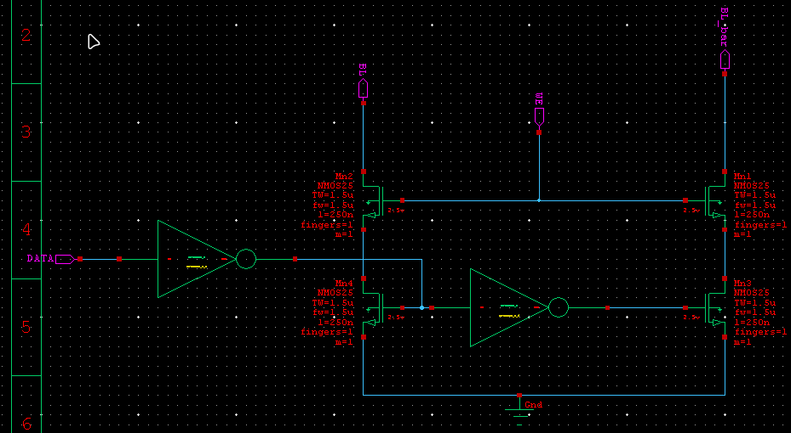
Building Blocks and Schematics
Row decoder
The Row decoder is NOR based 2:4 Decoder. The word line is selected based on inputs given to the decoder.
Write driver circuit.
Write driver circuits provide the data which is the input to the
bit lines. The circuit is controlled by the Write Enable (WE) signal. Whenever WE = 1 (High),

Slide 8
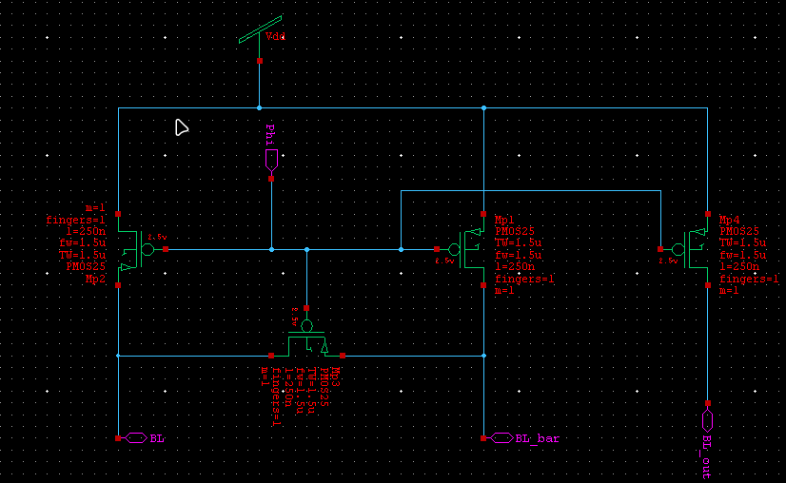
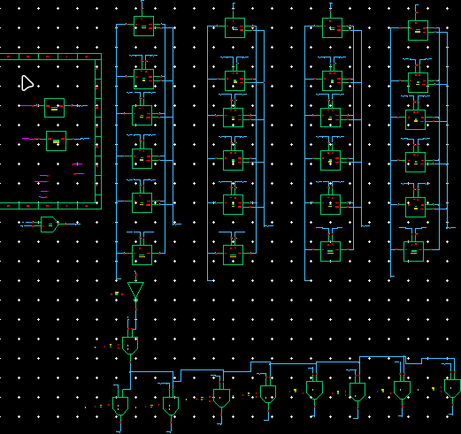
Building Blocks and Schematics
Pre-charge circuit
With the help of precharge circuit, the RBL line is charged to
VDD. The read operation is carried out and the output obtained will be given to the sense amplifier. A precharge circuit consists of a precharge time controller to generate the precharge time control signal based on a threshold voltage of a transistor;
The 4X4 8 T SRAM Cell array has been designed with the exiting
8 T SRAM Cell. In addition to the 8 T SRAM cell, the internal circuits involving 2:4 Decoder, precharge circuit, write driver circuit.

Slide 9
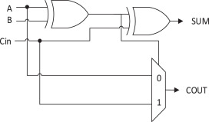
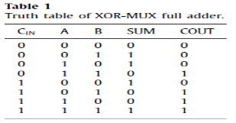
Building Blocks and Schematics
The ALU:
as for the design of the ALU it will be divided to three circuits :
Carry Adder
Logic Unit
Barrel Shifter
As for the carry adder the building block of the full adder is made of is a two XOR cells with 2x1 MUX for the cout
the shows the proposed architecture of XOR MUX Full adder design while employing the two successive stages of XOR gate for Sum operations and 2:1 non-inverting multiplexer while using for Carry operations

Slide 10
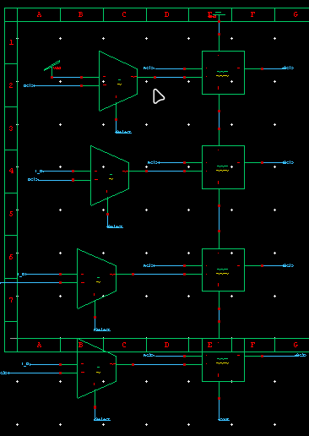
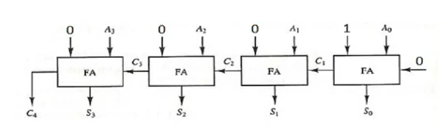
Building Blocks and Schematics
Now for the input B there’s a Mux connected to decide whether to pass the B input or to perform the other two operation requested from the Adder unit : Increment and decrement :
As for the incrementer using units of full adders the design decided as following

Slide 11
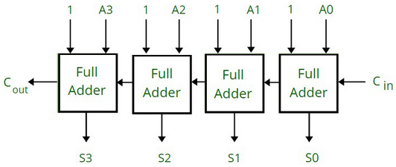
Building Blocks and Schematics
The Decrementer:
And in that fashion the first dull adder is always 1 while the others will be choosing between the 0 and 1 values to choose between increment or decrement respectively.
The value of Cin in all cases will be zero.

Slide 12
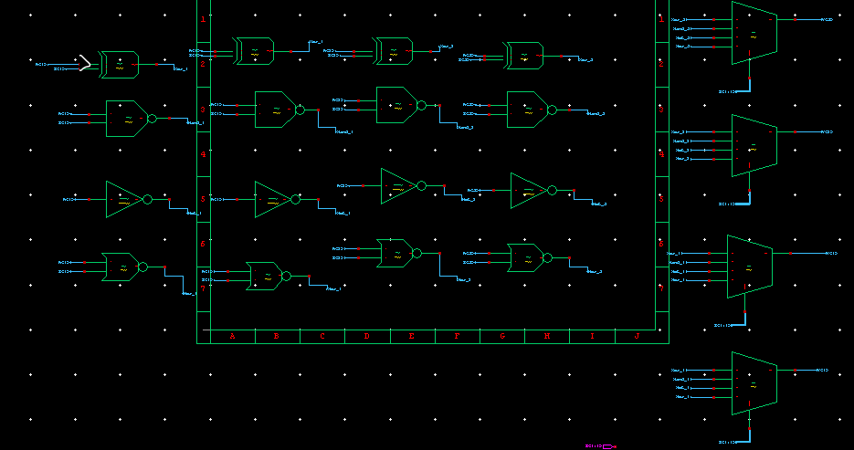
Building Blocks and Schematics
The Logic Unit
in the Logic unit the operation that we need to process is one of the following :
NAND
XOR
Invert
NOR
And this is deployed as shown below for each input bit of A and B we can decide to choose which operation to be output with the help of 4x1 MUX unit that decides which operation on the basis of the select signal that is inserted by the Opcode to choose which operation to appear on the output.

Slide 13
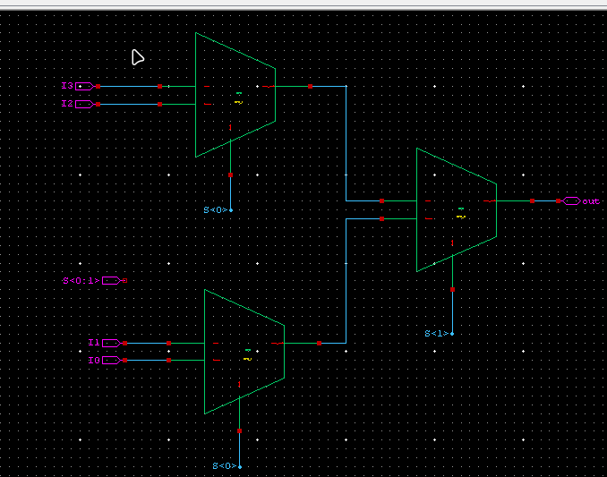
Building Blocks and Schematics
The 4x1 Mux is built on the Notion of two 2x1 Muxes on the first stage and then brached to a second phase MUX with a second signal select as below:

Slide 14
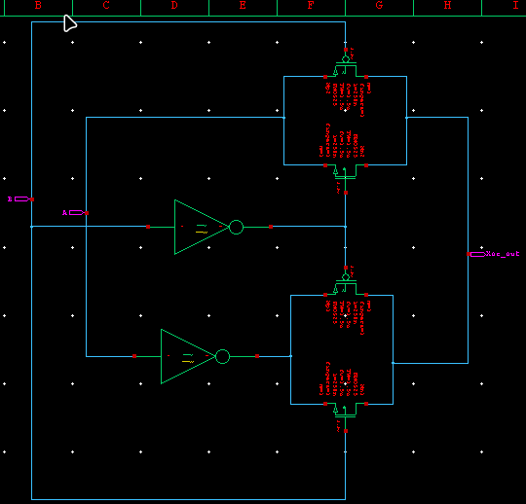
Building Blocks and Schematics
The basic building blocks of this unit is :
XOR:
The circuit shown here realizes the XOR function of inputs A and B using just six transistors. The first stage of the circuit consists of a basic static inverter, which generates the inverse of input A.

Slide 15
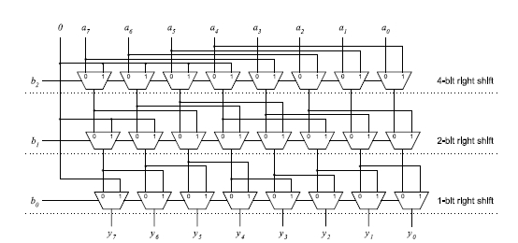
Building Blocks and Schematics
The Shifter:
Shifting and rotating data is required in several applications including arithmetic operations, variable-length
coding, and bit-indexing. Consequently, barrel shifters, which are capable of shifting or rotating data in a single
cycle, are commonly found in both digital signal processors and general-purpose processors

Slide 16
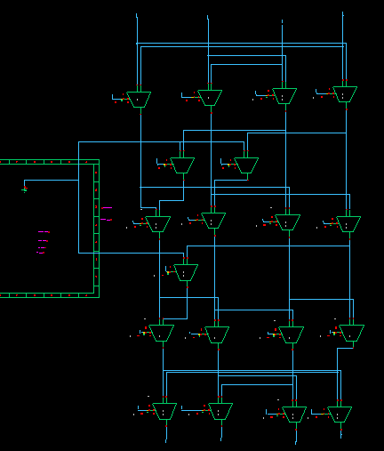
Building Blocks and Schematics
By adding the data reversal decoding line in the start and the end of the array
This design can perform the following :
• Pass (no shift)
• Shift left 1.
• Shift left 2.
• Shift right 1.
• Shift right 2.
• Rotate right 1.
• Rotate left 1.

Slide 17
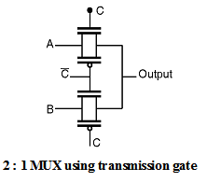
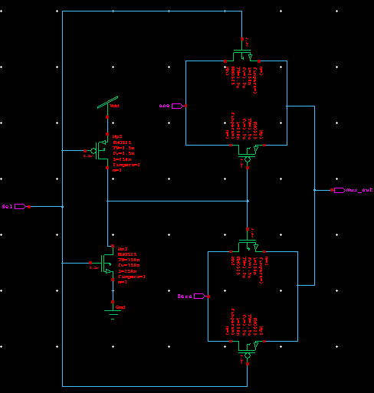
Building Blocks and Schematics
The building block of this design is the following:
2x1 MUX
When the control signal C is low then the upper transmission gate turns OFF and it will not allow A to pass through it, at the same time the lower transmission gate is 'ON' and it allows B to pass through it so the output = B.

Slide 18
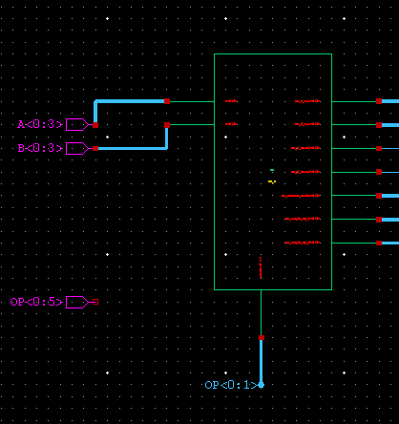
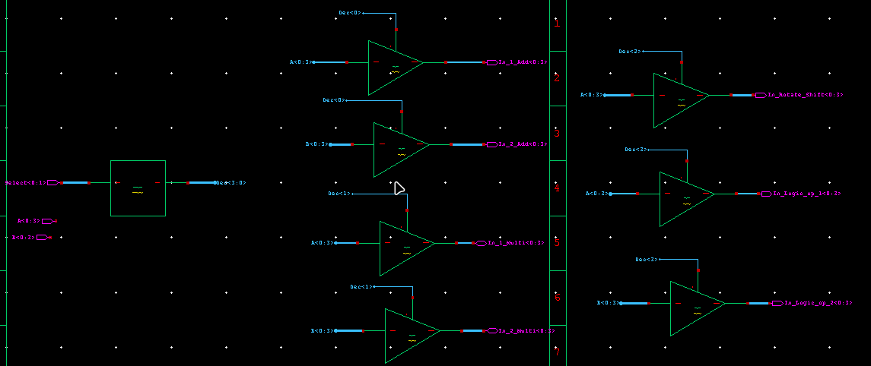
Building Blocks and Schematics
The control unit presented is designed to be a low-power which works only while an operation decoded; otherwise it will be off. It consists of a 2-4 bit decoder that decodes the OP code and the output values will be the enable signals of the tri-state buffers which control the operand transmission to the following blocks. There’s two outputs reserved for future to implement the Multiplier cell.

Slide 19
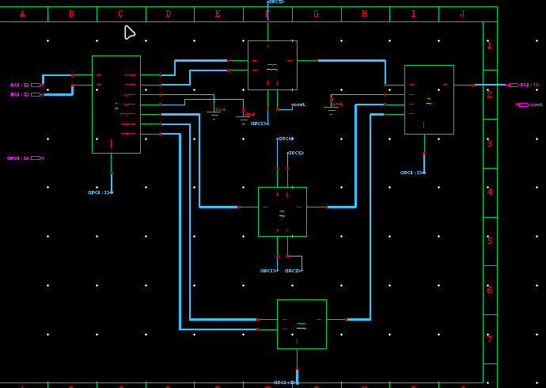
Building Blocks and Schematics
An the whole ALU Unit schematic is as follows

Slide 20
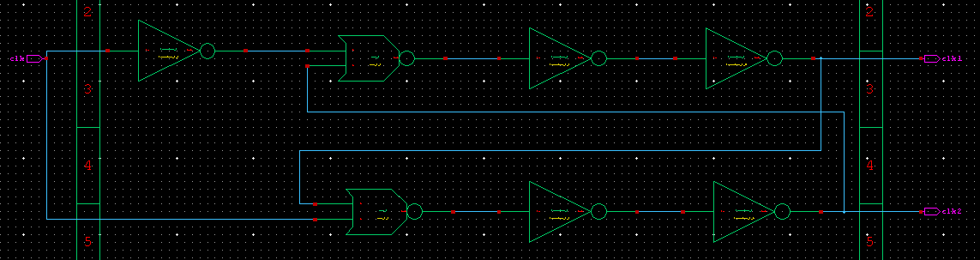
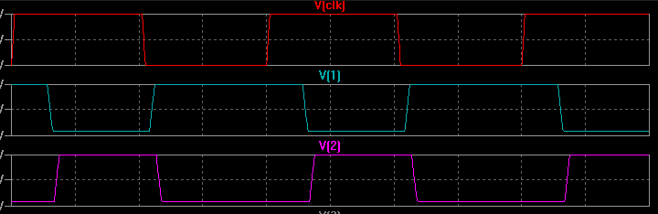
Building Blocks and Schematics
The two phase Generator:
This NOR-flipflop based circuit implements a non-overlapping two-phase clock signal generator and can be used to derive a two-phase clock signal from a single and possibly non-symmetrical clock signal

Slide 21
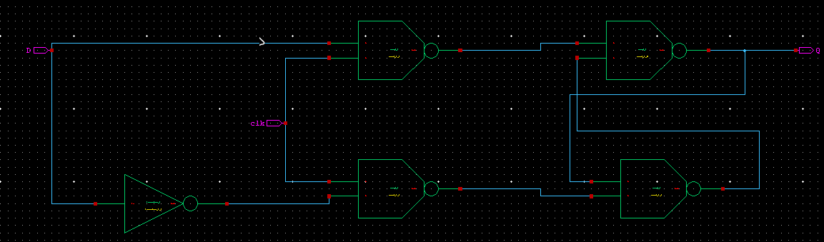
Building Blocks and Schematics
The Latches:
D latches are also known as transparent latches and are implemented using two inputs: D (Data) and a clock signal. The output of the latch follows the input at the D terminal as long as the clock signal is high. When the clock signal goes low, the output of the latch is stored and held until the next rising edge of the clock.

Slide 22
Content
Overview on 4bit Microprocessor
Building Blocks and Schematics
Layout Design
Design Validation
Back Annotation Simulation Results

Slide 23
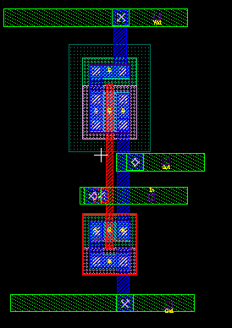
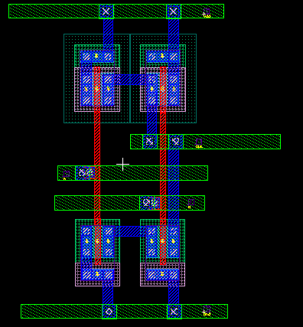
Layout Design of the Cell
The inverter :
The NAND:

Slide 24
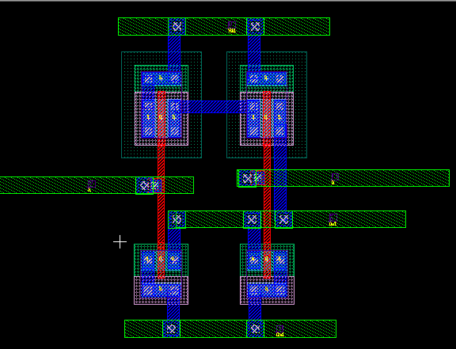
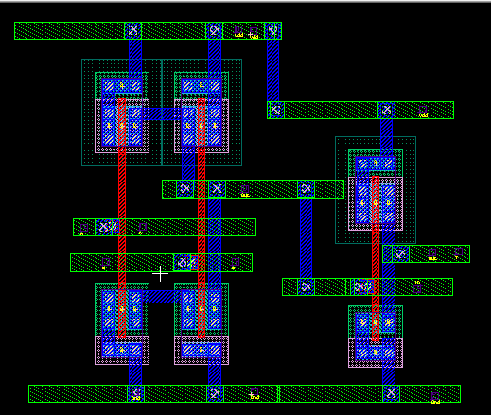
Layout Design of the Cell
The NOR:
The AND:

Slide 25
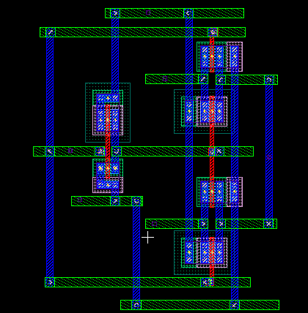
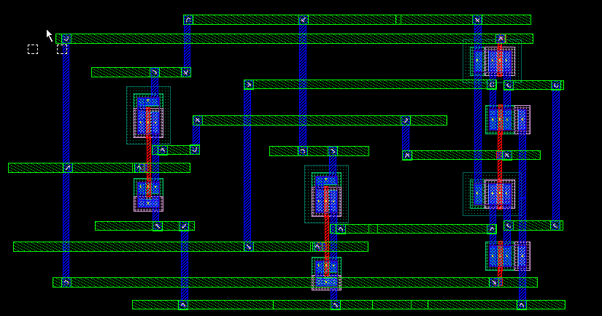
Layout Design of the Cell
The MUX:
The XOR :

Slide 26
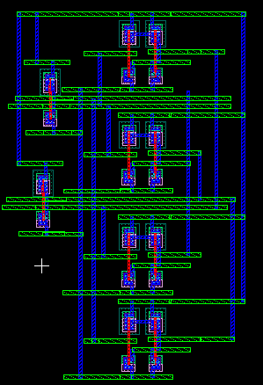
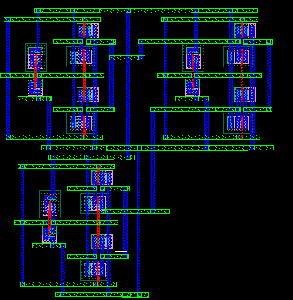
Layout Design of the Cell
The 4x1 MUX:
The 2x4 Decoder:

Slide 27
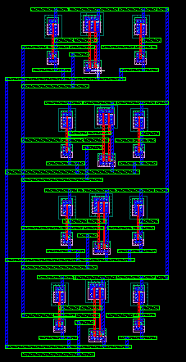
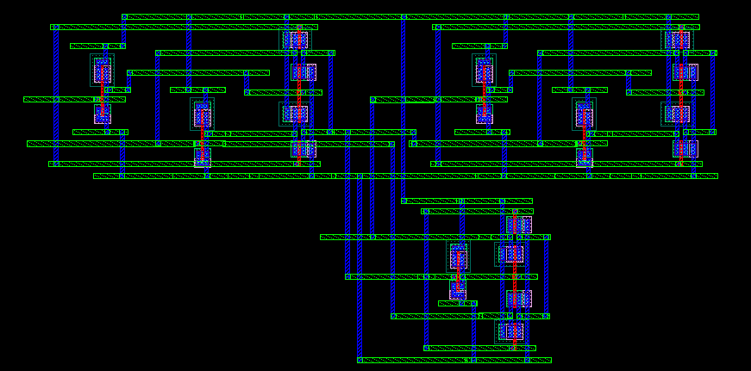
Layout Design of the Cell
Tri state Buffer :
The One bit adder :

Slide 28
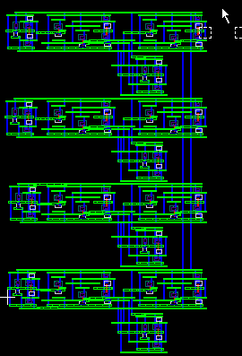
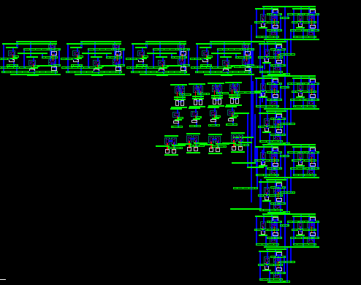
Layout Design of the Cell
The Adder Unit:
The Logic Operation Unit:

Slide 29
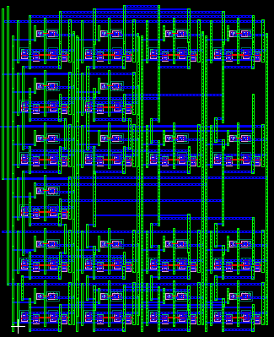
Layout Design of the Cell
The barrel shifter:
The MUX Selector:

Slide 30
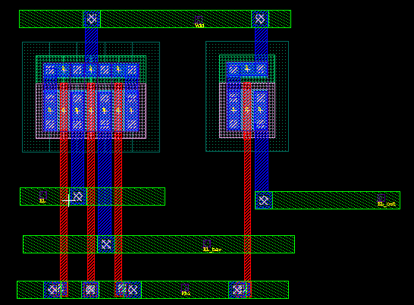
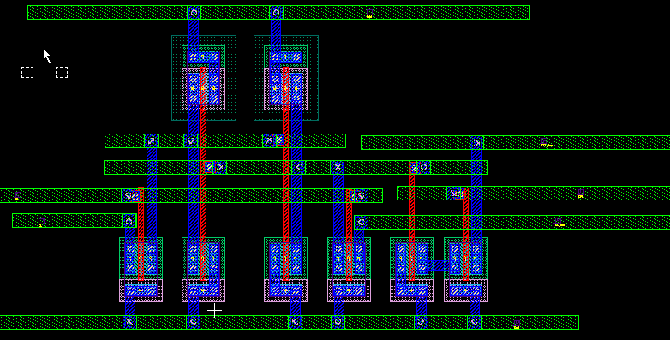
Layout Design of the Cell
The SRAM building Blocks layout :
The 8t SRAM cell :
The Precharge unit :

Slide 31
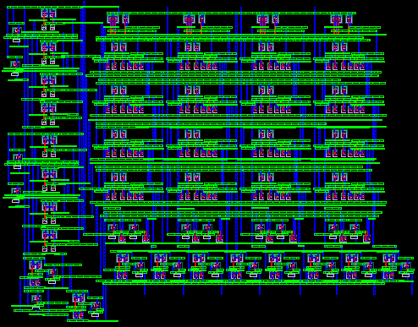
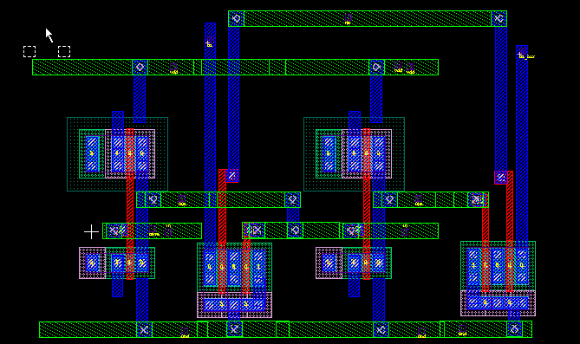
Layout Design of the Cell
The whole SRAM ARRAY:
The write driver :

Slide 32
Content
Overview on 4bit Microprocessor
Building Blocks and Schematics
Layout Design
Design Validation
Back Annotation Simulation Results

Slide 33
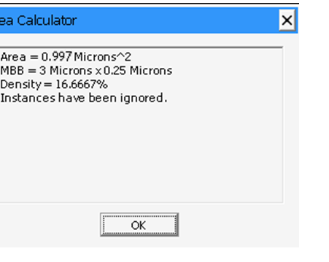
Design Validation
The Area Of the 4bit Microprocessor cell
DRC Passed !

Slide 34
Design Validation
LVS Passed !

Slide 35
Design Validation
PEX Passed !

Slide 36
Content
Overview on 4bit Microprocessor
Building Blocks and Schematics
Layout Design
Design Validation
Back Annotation Simulation Results

Slide 37
Back Annotation Simulation Results
After the Parasitic Extraction
Back annotation is performed, which result to a schematic version called “no wire schematic”

Slide 38
Back Annotation Simulation Results
As for the simulation :ALU simulation :
Case 1, Adding A+B = 10001
Simulation Results after accurate values of all the parasitics are included

Slide 39
Back Annotation Simulation Results
Case 2, Shifting A>>B
Simulation Results after accurate values of all the parasitics are included

Slide 40
Back Annotation Simulation Results
2x4 Decoder :
Simulation Results after accurate values of all the parasitics are included

Slide 41
Back Annotation Simulation Results
4x4 SRAM array waveform:
Simulation Results after accurate values of all the parasitics are included

Slide 42
Thanks

